Slide 1

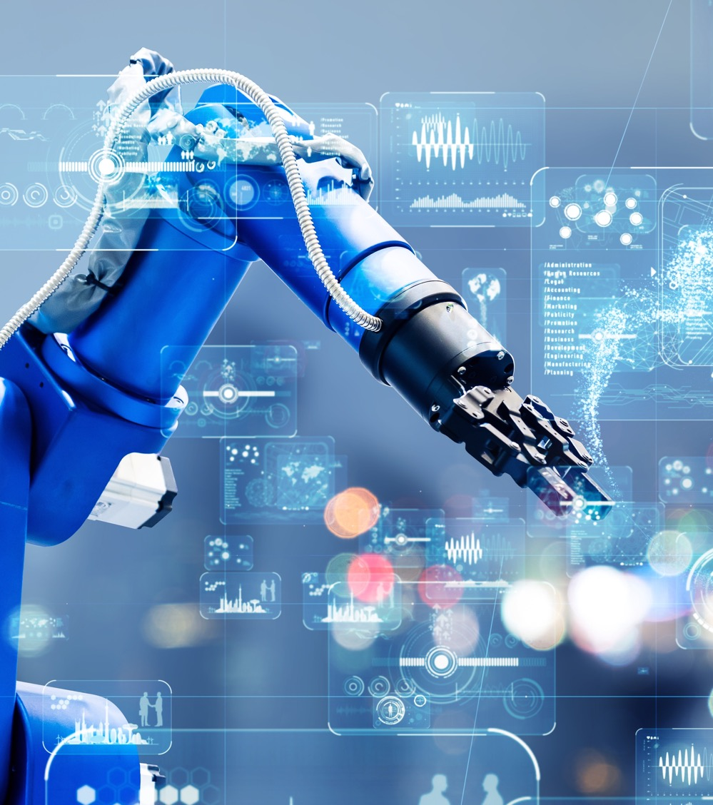

Technology Office
Real-Time Meets Cloud ROS 2 on VxWorks and Linux with Kubernetes
WIND RIVER
Andrei Kholodnyi
Principal Technologist
27th of Oct 2025

Slide 2

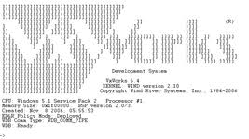
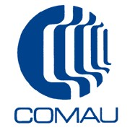

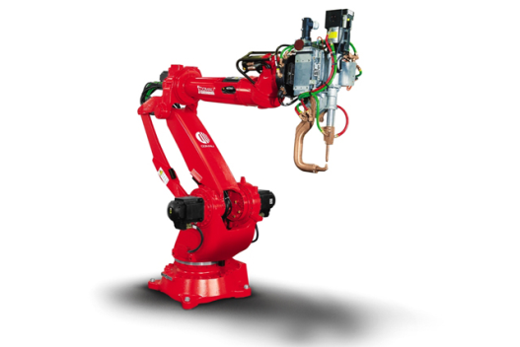
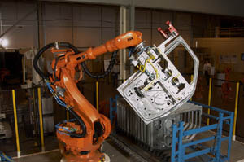


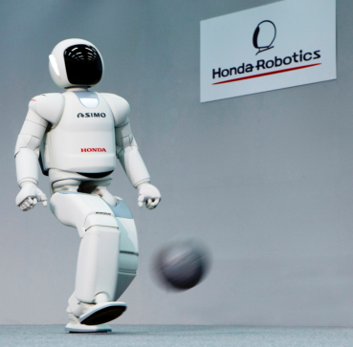


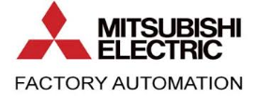
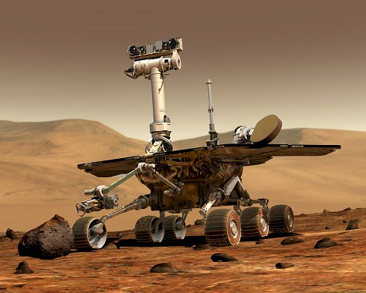

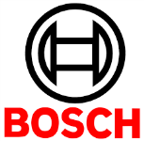
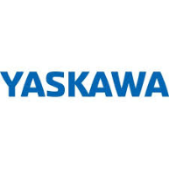
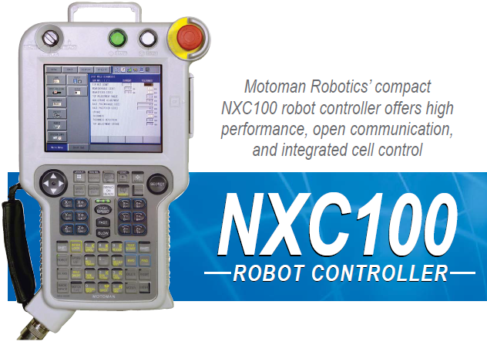

What is VxWorks and who is Wind River
TECHNOLOGY OFFICE
32 / 64 bits, uP / SMP RTOS
ARM / Intel / MIPS / PowerPC
Proprietary kernel APIs, kernel-level C/C++ env including POSIX
User level process (user level optional)
C/C++14/17, possible to develop kernel C++ modules and user apps
Safety certifiable, DO-178, ISO 26262, IEC 61508
Toolchain LLVM 17, Dinkum C/C++ libs
Proprietary build system
Kernel shell
VSCode, Eclipse Windows / Linux / Cloud
Notes:
With many organizations increasingly adopting cloud infrastructure for rapid operation processes, the demand for cloud robotics systems is rising in multi-folds. Moreover, improving internet connectivity led by vast deployments of cloud networks impact the market landscape positively.
Development in software structures and wireless technology progress defines the growing market landscape, increasing the dependence of industries on robotic cloud systems. Cloud robotics platforms provide on-demand automation solutions for material handling and inventory management in warehousing applications.
The rising use of cloud robotics in growing numbers of manufacturing, distribution, and fulfillment centers for various material handling tasks offers large opportunities to market players. Furthermore, improving official safety standards governing the design and manufacture of industrial mobile robots impacts the market growth positively
The COVID19 lockdown measures forced the industrial sector to shut down their production work which disrupted the supply chain. Many organizations faced challenges in functioning operations and manual working practices due to the lockdown restrictions. However, the global market was still maintaining its growth and never been in a low phase. The reason behind the exponential growth is the increased migration of industries in adopting automated operational systems instead of manual techniques. The increase in demand for automated systems creates an unexpected rise in the global cloud robotics market. Cloud robotics market sales are expected to reach greater heights in the upcoming years.
The cloud robotics market trends are blooming in the field of artificial intelligence and produce vast opportunities for the global market. More and more industries are accepting cloud robotics technology as it has benefits of both robotics as well as cloud-based systems. The robotics features provide sensation, control, and actuation to the systems, whereas the cloud technology provides on-demand, convenient, and omnipresent network access.
Higher installation cost restricts enterprises to adopt the technology and opt for a much cheaper option. Another major challenge in the market is the shortage of technical expertise in the industries that restrain the growth of the market.
The cloud robotics market segments on the basis of application include defense, healthcare, manufacturing, retail, transportation, aerospace, agriculture, and many other sectors. The market segment on the basis of connectivity comprises Wi-Fi, 5G, Bluetooth, radiofrequency, and infrared connectivity. The market segment on the basis of type involves proxy-based, clone-based, and peer-based cloud robotics.
enabling cloud robotics to integrate the functionalities of edge computing and benefits of ultra-low network latency with the help of modern 5G networks. With faster communication networks, robots and system automation have shifted from being the future innovations of the research labs to actually becoming a crucial cost, time, and energy-saving element of modern industries and businesses. Intelligent robots and their control systems have enabled entire processes, like vehicle assembly, to be carried out automatically. By adding mobility to the mix, the possibilities to include system automation in almost any industry increases dramatically. Moreover, the basic characteristic that determines the stability and operability of cloud-controlled robot control is the network latency, and so for most use cases, 4G is a good starting point to provide connectivity. But with newer technologies such as 5G, which supports a wider range of requirements including sub-millisecond latency, it can fulfill both the bandwidth and latency needs that applications such as remote-control robotics may require.
Advent of 5G technology can provide major growth opportunities over the forecast period
Deployment of cloud-based robotic systems requires reliable and constant connectivity, regardless of the environment it operates within. Wireless technology offers these solutions and eliminates the need for complex wireline connections to provide communication systems. Moreover, 5G is expected to offer very low latency and is an obvious choice for applications that require high capacity. 5G supports a wider range of requirements such as sub-millisecond latency. For instance, Ericsson has partnered with biomedical companies such as EI.En and Imaginalis for robotic-assisted surgeries and remote diagnosis.
Technological advancements in robotic applications are expected to present lucrative business opportunities
The development in the robotics industry has enabled new robots to perform a plethora of applications. Robots can now perceive, manipulate, place and pick a wide variety of objects in less structured environments. Cloud robotics is considered as a step-further in this, enabling major advancements in automotive and other industrial applications. For instance, Google’s driverless cars are cloud robots, these cars use cloud services to navigate using Google’s enormous database of satellite and maps. These cars combine this data with current and past traffic patterns to avoid collisions.
Clone-based robots are gaining traction in the market at a higher rate with increasing adoption of cloud robotics. In clone-based robots, the applications or tasks can be divided between the robots or its clone in the cloud. Robotic clones can form an enhanced network with strong connectivity for improved data transfer and connectivity. For instance, CA Technologies has developed cloning systems for various robotic applications. This cloning platform avoids robot device ID duplication for improved results and elimination of unexpected results.

Slide 3

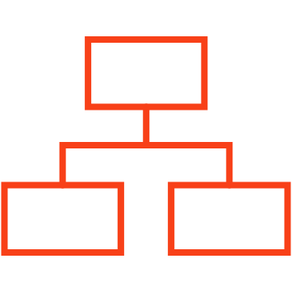
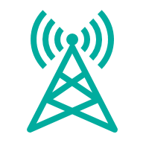
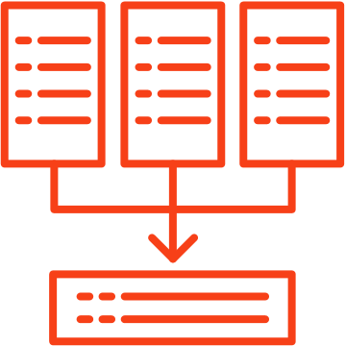


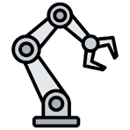
TRANSITION TO SOFTWARE-DEFINED
TECHNOLOGY OFFICE
TRANSITIONING TO SOFTWARE-DEFINED WHILE MAINTAINING SAFETY, SECURITY AND RELIABILITY
OPTIMIZED
HARDWARE
CLOUD-NATIVE SOFTWARE
EDGE-TO-CLOUD CONNECTIVITY
TRANSFORMATIONAL VALUE DRIVERS
Consumer / Enterprise
Deployed at scale
UP-INTEGRATION
Centralization and up-integration of features and functions
Telecom
In production and in the process of scaling up
VIRTUALIZATION
Virtual computing environment fully abstracted from underlying hardware
A&D
Next-gen hardware in production
ARTIFICIAL INTELLIGENCE
In development
Insights from data developed by advanced algorithms
Robotics

Slide 4
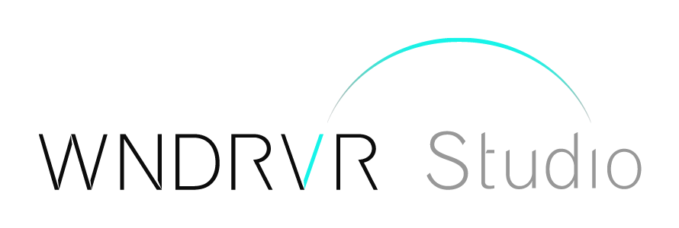
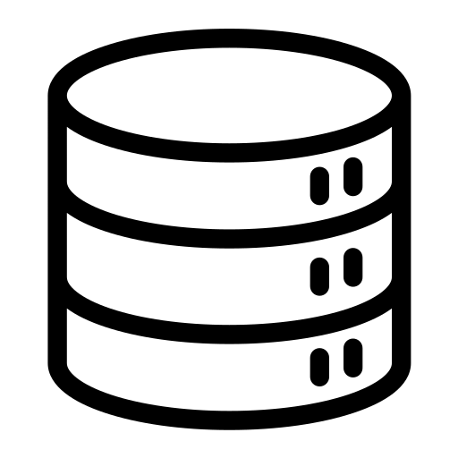
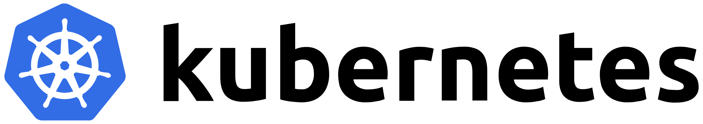
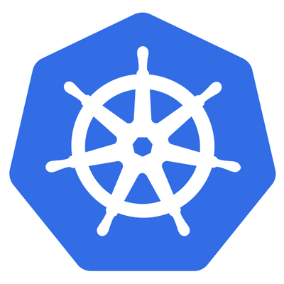
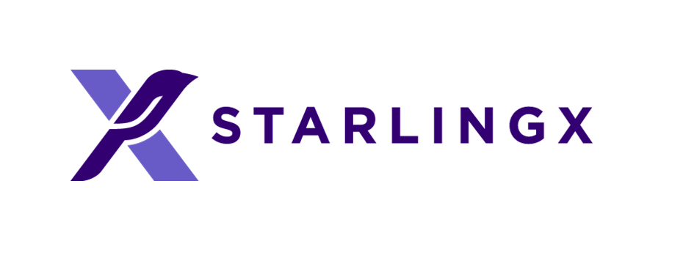
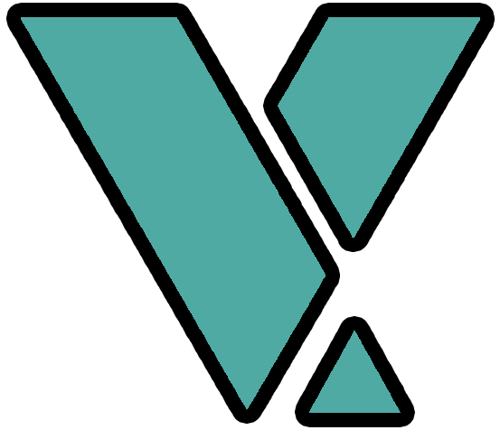
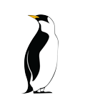




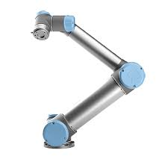


THE CLOUDIFICATION OF EMBEDDED SYSTEMS
TECHNOLOGY OFFICE
Registry
Container
Container
Container
Container
Kubelet
Container
Container
Container
Container
VxKubelet
Container
K8s Master
Container Orchestration
Container
Platform Management
Container
Container
Container
Container
Kubelet
Container
Container
VxKubelet
Container
Container
Kubelet
Container
Safety - VxWorks
Linux
Linux
Mixed Criticality Hypervisor - Helix
Safety - VxWorks
Up-Integrated Central Compute
Linux
Android
Mixed Criticality Hypervisor - Helix
Up-Integrated Zonal Compute
Container
Container
Container
Container
Container
Container
VxKubelet
Container
Embedded OS - VxWorks
Embedded Sensor / Control
Continuous development, deployment and operations of all vehicle software systems

Slide 5
Worker Node 1
VxWOrks / LiNUX KUBERNETES
WR BLACK
HEX 1C1C1C
Worker Node 1 - Linux
WR TEAL
HEX 00ADA4
Pod 1
Pod 2
Pod 3
WR SEA
HEX 30E4D0
WR GREY
HEX A6A6A6
Container 1
Container 1
Container 2
Container 1
Container 2
Container 3
WR RED
HEX FF505C
User Interface
UI
Control Plane
kubelet
kube-proxy
API Server
Scheduler
kubectl
Controller-Manager
Worker Node 2 -VxWorks
WR MINT
HEX A3DAD6
CLI
WR CELADON
HEX 6C9694
etcd
Pod 1
Pod 2
Pod 3
Container 1
Container 1
Container 1
Container 2
WR GRANITE
HEX 727272
WR SLATE
HEX 505050
Container 3
Container 2
kubelet
kube-proxy
WR CHAMPAGNE
HEX FFD199
WR CORAL
HEX F5AEB0

Slide 6
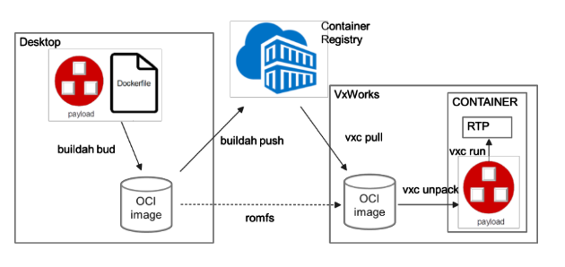
ROS2 containers on VxWorks

Slide 7
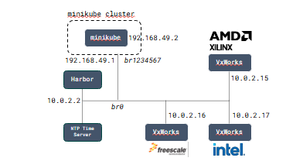
ROS2 VxWorks/Linux Kubernetes demo

Slide 8
Key Takeaways - Real-time + cloud-native = the future of edge robotics.
ROS 2 containers unify development for RTOS and Linux.
Kubernetes orchestration extends to real-time edge.
Hybrid architecture bridges embedded determinism with cloud scalability.
Wind River enabling end-to-end edge robotics deployments.
Notes:
With many organizations increasingly adopting cloud infrastructure for rapid operation processes, the demand for cloud robotics systems is rising in multi-folds. Moreover, improving internet connectivity led by vast deployments of cloud networks impact the market landscape positively.
Development in software structures and wireless technology progress defines the growing market landscape, increasing the dependence of industries on robotic cloud systems. Cloud robotics platforms provide on-demand automation solutions for material handling and inventory management in warehousing applications.
The rising use of cloud robotics in growing numbers of manufacturing, distribution, and fulfillment centers for various material handling tasks offers large opportunities to market players. Furthermore, improving official safety standards governing the design and manufacture of industrial mobile robots impacts the market growth positively
The COVID19 lockdown measures forced the industrial sector to shut down their production work which disrupted the supply chain. Many organizations faced challenges in functioning operations and manual working practices due to the lockdown restrictions. However, the global market was still maintaining its growth and never been in a low phase. The reason behind the exponential growth is the increased migration of industries in adopting automated operational systems instead of manual techniques. The increase in demand for automated systems creates an unexpected rise in the global cloud robotics market. Cloud robotics market sales are expected to reach greater heights in the upcoming years.
The cloud robotics market trends are blooming in the field of artificial intelligence and produce vast opportunities for the global market. More and more industries are accepting cloud robotics technology as it has benefits of both robotics as well as cloud-based systems. The robotics features provide sensation, control, and actuation to the systems, whereas the cloud technology provides on-demand, convenient, and omnipresent network access.
Higher installation cost restricts enterprises to adopt the technology and opt for a much cheaper option. Another major challenge in the market is the shortage of technical expertise in the industries that restrain the growth of the market.
The cloud robotics market segments on the basis of application include defense, healthcare, manufacturing, retail, transportation, aerospace, agriculture, and many other sectors. The market segment on the basis of connectivity comprises Wi-Fi, 5G, Bluetooth, radiofrequency, and infrared connectivity. The market segment on the basis of type involves proxy-based, clone-based, and peer-based cloud robotics.
enabling cloud robotics to integrate the functionalities of edge computing and benefits of ultra-low network latency with the help of modern 5G networks. With faster communication networks, robots and system automation have shifted from being the future innovations of the research labs to actually becoming a crucial cost, time, and energy-saving element of modern industries and businesses. Intelligent robots and their control systems have enabled entire processes, like vehicle assembly, to be carried out automatically. By adding mobility to the mix, the possibilities to include system automation in almost any industry increases dramatically. Moreover, the basic characteristic that determines the stability and operability of cloud-controlled robot control is the network latency, and so for most use cases, 4G is a good starting point to provide connectivity. But with newer technologies such as 5G, which supports a wider range of requirements including sub-millisecond latency, it can fulfill both the bandwidth and latency needs that applications such as remote-control robotics may require.
Advent of 5G technology can provide major growth opportunities over the forecast period
Deployment of cloud-based robotic systems requires reliable and constant connectivity, regardless of the environment it operates within. Wireless technology offers these solutions and eliminates the need for complex wireline connections to provide communication systems. Moreover, 5G is expected to offer very low latency and is an obvious choice for applications that require high capacity. 5G supports a wider range of requirements such as sub-millisecond latency. For instance, Ericsson has partnered with biomedical companies such as EI.En and Imaginalis for robotic-assisted surgeries and remote diagnosis.
Technological advancements in robotic applications are expected to present lucrative business opportunities
The development in the robotics industry has enabled new robots to perform a plethora of applications. Robots can now perceive, manipulate, place and pick a wide variety of objects in less structured environments. Cloud robotics is considered as a step-further in this, enabling major advancements in automotive and other industrial applications. For instance, Google’s driverless cars are cloud robots, these cars use cloud services to navigate using Google’s enormous database of satellite and maps. These cars combine this data with current and past traffic patterns to avoid collisions.
Clone-based robots are gaining traction in the market at a higher rate with increasing adoption of cloud robotics. In clone-based robots, the applications or tasks can be divided between the robots or its clone in the cloud. Robotic clones can form an enhanced network with strong connectivity for improved data transfer and connectivity. For instance, CA Technologies has developed cloning systems for various robotic applications. This cloning platform avoids robot device ID duplication for improved results and elimination of unexpected results.

Slide 9
The Challenge: Real-Time Meets Cloud
Key message: Traditional real-time systems and cloud-native architectures live in different worlds.
Content:
RTOS world: deterministic, safety-critical, resource-constrained.
Cloud world: scalable, flexible, orchestrated, but not deterministic.
ROS 2 needs both: real-time control + cloud-scale intelligence.
Visuals:
Split diagram: Edge (RTOS) ↔ Cloud (Kubernetes).
Latency, determinism, scalability metrics shown as trade-offs.
Talking points:
Real-time constraints on robots don’t go away when you move to the cloud.
Need an integrated model that spans real-time edge and cloud orchestration.
Notes:
With many organizations increasingly adopting cloud infrastructure for rapid operation processes, the demand for cloud robotics systems is rising in multi-folds. Moreover, improving internet connectivity led by vast deployments of cloud networks impact the market landscape positively.
Development in software structures and wireless technology progress defines the growing market landscape, increasing the dependence of industries on robotic cloud systems. Cloud robotics platforms provide on-demand automation solutions for material handling and inventory management in warehousing applications.
The rising use of cloud robotics in growing numbers of manufacturing, distribution, and fulfillment centers for various material handling tasks offers large opportunities to market players. Furthermore, improving official safety standards governing the design and manufacture of industrial mobile robots impacts the market growth positively
The COVID19 lockdown measures forced the industrial sector to shut down their production work which disrupted the supply chain. Many organizations faced challenges in functioning operations and manual working practices due to the lockdown restrictions. However, the global market was still maintaining its growth and never been in a low phase. The reason behind the exponential growth is the increased migration of industries in adopting automated operational systems instead of manual techniques. The increase in demand for automated systems creates an unexpected rise in the global cloud robotics market. Cloud robotics market sales are expected to reach greater heights in the upcoming years.
The cloud robotics market trends are blooming in the field of artificial intelligence and produce vast opportunities for the global market. More and more industries are accepting cloud robotics technology as it has benefits of both robotics as well as cloud-based systems. The robotics features provide sensation, control, and actuation to the systems, whereas the cloud technology provides on-demand, convenient, and omnipresent network access.
Higher installation cost restricts enterprises to adopt the technology and opt for a much cheaper option. Another major challenge in the market is the shortage of technical expertise in the industries that restrain the growth of the market.
The cloud robotics market segments on the basis of application include defense, healthcare, manufacturing, retail, transportation, aerospace, agriculture, and many other sectors. The market segment on the basis of connectivity comprises Wi-Fi, 5G, Bluetooth, radiofrequency, and infrared connectivity. The market segment on the basis of type involves proxy-based, clone-based, and peer-based cloud robotics.
enabling cloud robotics to integrate the functionalities of edge computing and benefits of ultra-low network latency with the help of modern 5G networks. With faster communication networks, robots and system automation have shifted from being the future innovations of the research labs to actually becoming a crucial cost, time, and energy-saving element of modern industries and businesses. Intelligent robots and their control systems have enabled entire processes, like vehicle assembly, to be carried out automatically. By adding mobility to the mix, the possibilities to include system automation in almost any industry increases dramatically. Moreover, the basic characteristic that determines the stability and operability of cloud-controlled robot control is the network latency, and so for most use cases, 4G is a good starting point to provide connectivity. But with newer technologies such as 5G, which supports a wider range of requirements including sub-millisecond latency, it can fulfill both the bandwidth and latency needs that applications such as remote-control robotics may require.
Advent of 5G technology can provide major growth opportunities over the forecast period
Deployment of cloud-based robotic systems requires reliable and constant connectivity, regardless of the environment it operates within. Wireless technology offers these solutions and eliminates the need for complex wireline connections to provide communication systems. Moreover, 5G is expected to offer very low latency and is an obvious choice for applications that require high capacity. 5G supports a wider range of requirements such as sub-millisecond latency. For instance, Ericsson has partnered with biomedical companies such as EI.En and Imaginalis for robotic-assisted surgeries and remote diagnosis.
Technological advancements in robotic applications are expected to present lucrative business opportunities
The development in the robotics industry has enabled new robots to perform a plethora of applications. Robots can now perceive, manipulate, place and pick a wide variety of objects in less structured environments. Cloud robotics is considered as a step-further in this, enabling major advancements in automotive and other industrial applications. For instance, Google’s driverless cars are cloud robots, these cars use cloud services to navigate using Google’s enormous database of satellite and maps. These cars combine this data with current and past traffic patterns to avoid collisions.
Clone-based robots are gaining traction in the market at a higher rate with increasing adoption of cloud robotics. In clone-based robots, the applications or tasks can be divided between the robots or its clone in the cloud. Robotic clones can form an enhanced network with strong connectivity for improved data transfer and connectivity. For instance, CA Technologies has developed cloning systems for various robotic applications. This cloning platform avoids robot device ID duplication for improved results and elimination of unexpected results.

Slide 10
Architecture: Hybrid ROS 2 Deployment
Key message: Unified deployment model for ROS 2 on RTOS and Linux.
Content:
ROS 2 nodes containerized using OCI-compatible containers.
VxWorks and Linux both run ROS 2 containers.
Kubernetes manages both — one control plane, multiple execution targets.
Visuals:
Architecture diagram:
Kubernetes master node (on Linux)
Edge nodes: Linux and VxWorks
ROS 2 topics spanning both.
Talking points:
How Wind River enables OCI containers on VxWorks.
Common build pipeline for RTOS and Linux containers.
Benefits: consistency, manageability, portability.
Notes:
With many organizations increasingly adopting cloud infrastructure for rapid operation processes, the demand for cloud robotics systems is rising in multi-folds. Moreover, improving internet connectivity led by vast deployments of cloud networks impact the market landscape positively.
Development in software structures and wireless technology progress defines the growing market landscape, increasing the dependence of industries on robotic cloud systems. Cloud robotics platforms provide on-demand automation solutions for material handling and inventory management in warehousing applications.
The rising use of cloud robotics in growing numbers of manufacturing, distribution, and fulfillment centers for various material handling tasks offers large opportunities to market players. Furthermore, improving official safety standards governing the design and manufacture of industrial mobile robots impacts the market growth positively
The COVID19 lockdown measures forced the industrial sector to shut down their production work which disrupted the supply chain. Many organizations faced challenges in functioning operations and manual working practices due to the lockdown restrictions. However, the global market was still maintaining its growth and never been in a low phase. The reason behind the exponential growth is the increased migration of industries in adopting automated operational systems instead of manual techniques. The increase in demand for automated systems creates an unexpected rise in the global cloud robotics market. Cloud robotics market sales are expected to reach greater heights in the upcoming years.
The cloud robotics market trends are blooming in the field of artificial intelligence and produce vast opportunities for the global market. More and more industries are accepting cloud robotics technology as it has benefits of both robotics as well as cloud-based systems. The robotics features provide sensation, control, and actuation to the systems, whereas the cloud technology provides on-demand, convenient, and omnipresent network access.
Higher installation cost restricts enterprises to adopt the technology and opt for a much cheaper option. Another major challenge in the market is the shortage of technical expertise in the industries that restrain the growth of the market.
The cloud robotics market segments on the basis of application include defense, healthcare, manufacturing, retail, transportation, aerospace, agriculture, and many other sectors. The market segment on the basis of connectivity comprises Wi-Fi, 5G, Bluetooth, radiofrequency, and infrared connectivity. The market segment on the basis of type involves proxy-based, clone-based, and peer-based cloud robotics.
enabling cloud robotics to integrate the functionalities of edge computing and benefits of ultra-low network latency with the help of modern 5G networks. With faster communication networks, robots and system automation have shifted from being the future innovations of the research labs to actually becoming a crucial cost, time, and energy-saving element of modern industries and businesses. Intelligent robots and their control systems have enabled entire processes, like vehicle assembly, to be carried out automatically. By adding mobility to the mix, the possibilities to include system automation in almost any industry increases dramatically. Moreover, the basic characteristic that determines the stability and operability of cloud-controlled robot control is the network latency, and so for most use cases, 4G is a good starting point to provide connectivity. But with newer technologies such as 5G, which supports a wider range of requirements including sub-millisecond latency, it can fulfill both the bandwidth and latency needs that applications such as remote-control robotics may require.
Advent of 5G technology can provide major growth opportunities over the forecast period
Deployment of cloud-based robotic systems requires reliable and constant connectivity, regardless of the environment it operates within. Wireless technology offers these solutions and eliminates the need for complex wireline connections to provide communication systems. Moreover, 5G is expected to offer very low latency and is an obvious choice for applications that require high capacity. 5G supports a wider range of requirements such as sub-millisecond latency. For instance, Ericsson has partnered with biomedical companies such as EI.En and Imaginalis for robotic-assisted surgeries and remote diagnosis.
Technological advancements in robotic applications are expected to present lucrative business opportunities
The development in the robotics industry has enabled new robots to perform a plethora of applications. Robots can now perceive, manipulate, place and pick a wide variety of objects in less structured environments. Cloud robotics is considered as a step-further in this, enabling major advancements in automotive and other industrial applications. For instance, Google’s driverless cars are cloud robots, these cars use cloud services to navigate using Google’s enormous database of satellite and maps. These cars combine this data with current and past traffic patterns to avoid collisions.
Clone-based robots are gaining traction in the market at a higher rate with increasing adoption of cloud robotics. In clone-based robots, the applications or tasks can be divided between the robots or its clone in the cloud. Robotic clones can form an enhanced network with strong connectivity for improved data transfer and connectivity. For instance, CA Technologies has developed cloning systems for various robotic applications. This cloning platform avoids robot device ID duplication for improved results and elimination of unexpected results.

Slide 11
Real-Time in a Cloud-Native World
Key message: Determinism and orchestration can coexist.
Content:
Real-time containers run on RTOS (VxWorks).
Non-real-time and orchestration logic runs on Linux.
Communication through ROS 2 DDS middleware.
Integration with cloud for monitoring and deployment updates.
Visuals:
Timeline or flow diagram showing data moving from sensor (RTOS) → edge (Linux) → cloud (K8s dashboard).
Emphasize latency bounds, orchestration cycle.
Talking points:
Deterministic scheduling in VxWorks containers.
Kubernetes scheduling policies aware of real-time nodes (conceptually).
Unified observability across edge and cloud.
Notes:
With many organizations increasingly adopting cloud infrastructure for rapid operation processes, the demand for cloud robotics systems is rising in multi-folds. Moreover, improving internet connectivity led by vast deployments of cloud networks impact the market landscape positively.
Development in software structures and wireless technology progress defines the growing market landscape, increasing the dependence of industries on robotic cloud systems. Cloud robotics platforms provide on-demand automation solutions for material handling and inventory management in warehousing applications.
The rising use of cloud robotics in growing numbers of manufacturing, distribution, and fulfillment centers for various material handling tasks offers large opportunities to market players. Furthermore, improving official safety standards governing the design and manufacture of industrial mobile robots impacts the market growth positively
The COVID19 lockdown measures forced the industrial sector to shut down their production work which disrupted the supply chain. Many organizations faced challenges in functioning operations and manual working practices due to the lockdown restrictions. However, the global market was still maintaining its growth and never been in a low phase. The reason behind the exponential growth is the increased migration of industries in adopting automated operational systems instead of manual techniques. The increase in demand for automated systems creates an unexpected rise in the global cloud robotics market. Cloud robotics market sales are expected to reach greater heights in the upcoming years.
The cloud robotics market trends are blooming in the field of artificial intelligence and produce vast opportunities for the global market. More and more industries are accepting cloud robotics technology as it has benefits of both robotics as well as cloud-based systems. The robotics features provide sensation, control, and actuation to the systems, whereas the cloud technology provides on-demand, convenient, and omnipresent network access.
Higher installation cost restricts enterprises to adopt the technology and opt for a much cheaper option. Another major challenge in the market is the shortage of technical expertise in the industries that restrain the growth of the market.
The cloud robotics market segments on the basis of application include defense, healthcare, manufacturing, retail, transportation, aerospace, agriculture, and many other sectors. The market segment on the basis of connectivity comprises Wi-Fi, 5G, Bluetooth, radiofrequency, and infrared connectivity. The market segment on the basis of type involves proxy-based, clone-based, and peer-based cloud robotics.
enabling cloud robotics to integrate the functionalities of edge computing and benefits of ultra-low network latency with the help of modern 5G networks. With faster communication networks, robots and system automation have shifted from being the future innovations of the research labs to actually becoming a crucial cost, time, and energy-saving element of modern industries and businesses. Intelligent robots and their control systems have enabled entire processes, like vehicle assembly, to be carried out automatically. By adding mobility to the mix, the possibilities to include system automation in almost any industry increases dramatically. Moreover, the basic characteristic that determines the stability and operability of cloud-controlled robot control is the network latency, and so for most use cases, 4G is a good starting point to provide connectivity. But with newer technologies such as 5G, which supports a wider range of requirements including sub-millisecond latency, it can fulfill both the bandwidth and latency needs that applications such as remote-control robotics may require.
Advent of 5G technology can provide major growth opportunities over the forecast period
Deployment of cloud-based robotic systems requires reliable and constant connectivity, regardless of the environment it operates within. Wireless technology offers these solutions and eliminates the need for complex wireline connections to provide communication systems. Moreover, 5G is expected to offer very low latency and is an obvious choice for applications that require high capacity. 5G supports a wider range of requirements such as sub-millisecond latency. For instance, Ericsson has partnered with biomedical companies such as EI.En and Imaginalis for robotic-assisted surgeries and remote diagnosis.
Technological advancements in robotic applications are expected to present lucrative business opportunities
The development in the robotics industry has enabled new robots to perform a plethora of applications. Robots can now perceive, manipulate, place and pick a wide variety of objects in less structured environments. Cloud robotics is considered as a step-further in this, enabling major advancements in automotive and other industrial applications. For instance, Google’s driverless cars are cloud robots, these cars use cloud services to navigate using Google’s enormous database of satellite and maps. These cars combine this data with current and past traffic patterns to avoid collisions.
Clone-based robots are gaining traction in the market at a higher rate with increasing adoption of cloud robotics. In clone-based robots, the applications or tasks can be divided between the robots or its clone in the cloud. Robotic clones can form an enhanced network with strong connectivity for improved data transfer and connectivity. For instance, CA Technologies has developed cloning systems for various robotic applications. This cloning platform avoids robot device ID duplication for improved results and elimination of unexpected results.

Slide 12
Demo Overview
Key message: Hybrid ROS 2 system in action.
Content:
Show containers build download containers from registry using kubernetes unpck and run them monitor them
Notes:
With many organizations increasingly adopting cloud infrastructure for rapid operation processes, the demand for cloud robotics systems is rising in multi-folds. Moreover, improving internet connectivity led by vast deployments of cloud networks impact the market landscape positively.
Development in software structures and wireless technology progress defines the growing market landscape, increasing the dependence of industries on robotic cloud systems. Cloud robotics platforms provide on-demand automation solutions for material handling and inventory management in warehousing applications.
The rising use of cloud robotics in growing numbers of manufacturing, distribution, and fulfillment centers for various material handling tasks offers large opportunities to market players. Furthermore, improving official safety standards governing the design and manufacture of industrial mobile robots impacts the market growth positively
The COVID19 lockdown measures forced the industrial sector to shut down their production work which disrupted the supply chain. Many organizations faced challenges in functioning operations and manual working practices due to the lockdown restrictions. However, the global market was still maintaining its growth and never been in a low phase. The reason behind the exponential growth is the increased migration of industries in adopting automated operational systems instead of manual techniques. The increase in demand for automated systems creates an unexpected rise in the global cloud robotics market. Cloud robotics market sales are expected to reach greater heights in the upcoming years.
The cloud robotics market trends are blooming in the field of artificial intelligence and produce vast opportunities for the global market. More and more industries are accepting cloud robotics technology as it has benefits of both robotics as well as cloud-based systems. The robotics features provide sensation, control, and actuation to the systems, whereas the cloud technology provides on-demand, convenient, and omnipresent network access.
Higher installation cost restricts enterprises to adopt the technology and opt for a much cheaper option. Another major challenge in the market is the shortage of technical expertise in the industries that restrain the growth of the market.
The cloud robotics market segments on the basis of application include defense, healthcare, manufacturing, retail, transportation, aerospace, agriculture, and many other sectors. The market segment on the basis of connectivity comprises Wi-Fi, 5G, Bluetooth, radiofrequency, and infrared connectivity. The market segment on the basis of type involves proxy-based, clone-based, and peer-based cloud robotics.
enabling cloud robotics to integrate the functionalities of edge computing and benefits of ultra-low network latency with the help of modern 5G networks. With faster communication networks, robots and system automation have shifted from being the future innovations of the research labs to actually becoming a crucial cost, time, and energy-saving element of modern industries and businesses. Intelligent robots and their control systems have enabled entire processes, like vehicle assembly, to be carried out automatically. By adding mobility to the mix, the possibilities to include system automation in almost any industry increases dramatically. Moreover, the basic characteristic that determines the stability and operability of cloud-controlled robot control is the network latency, and so for most use cases, 4G is a good starting point to provide connectivity. But with newer technologies such as 5G, which supports a wider range of requirements including sub-millisecond latency, it can fulfill both the bandwidth and latency needs that applications such as remote-control robotics may require.
Advent of 5G technology can provide major growth opportunities over the forecast period
Deployment of cloud-based robotic systems requires reliable and constant connectivity, regardless of the environment it operates within. Wireless technology offers these solutions and eliminates the need for complex wireline connections to provide communication systems. Moreover, 5G is expected to offer very low latency and is an obvious choice for applications that require high capacity. 5G supports a wider range of requirements such as sub-millisecond latency. For instance, Ericsson has partnered with biomedical companies such as EI.En and Imaginalis for robotic-assisted surgeries and remote diagnosis.
Technological advancements in robotic applications are expected to present lucrative business opportunities
The development in the robotics industry has enabled new robots to perform a plethora of applications. Robots can now perceive, manipulate, place and pick a wide variety of objects in less structured environments. Cloud robotics is considered as a step-further in this, enabling major advancements in automotive and other industrial applications. For instance, Google’s driverless cars are cloud robots, these cars use cloud services to navigate using Google’s enormous database of satellite and maps. These cars combine this data with current and past traffic patterns to avoid collisions.
Clone-based robots are gaining traction in the market at a higher rate with increasing adoption of cloud robotics. In clone-based robots, the applications or tasks can be divided between the robots or its clone in the cloud. Robotic clones can form an enhanced network with strong connectivity for improved data transfer and connectivity. For instance, CA Technologies has developed cloning systems for various robotic applications. This cloning platform avoids robot device ID duplication for improved results and elimination of unexpected results.

Slide 13
Demo Overview
Key message: Hybrid ROS 2 system in action.
Content:
Recorded demo: ROS 2 nodes distributed across VxWorks and Linux.
Example: real-time motor control on RTOS + vision + AI inference on Linux edge.
Deployed and monitored with Kubernetes.
Visuals:
Screenshot or simplified flow from demo (container dashboard + robot diagram).
Callouts: “Same ROS 2 node API”, “Unified management”.
Talking points:
Show deployment and live orchestration in Kubernetes.
Emphasize developer simplicity: one model, two environments.
Notes:
With many organizations increasingly adopting cloud infrastructure for rapid operation processes, the demand for cloud robotics systems is rising in multi-folds. Moreover, improving internet connectivity led by vast deployments of cloud networks impact the market landscape positively.
Development in software structures and wireless technology progress defines the growing market landscape, increasing the dependence of industries on robotic cloud systems. Cloud robotics platforms provide on-demand automation solutions for material handling and inventory management in warehousing applications.
The rising use of cloud robotics in growing numbers of manufacturing, distribution, and fulfillment centers for various material handling tasks offers large opportunities to market players. Furthermore, improving official safety standards governing the design and manufacture of industrial mobile robots impacts the market growth positively
The COVID19 lockdown measures forced the industrial sector to shut down their production work which disrupted the supply chain. Many organizations faced challenges in functioning operations and manual working practices due to the lockdown restrictions. However, the global market was still maintaining its growth and never been in a low phase. The reason behind the exponential growth is the increased migration of industries in adopting automated operational systems instead of manual techniques. The increase in demand for automated systems creates an unexpected rise in the global cloud robotics market. Cloud robotics market sales are expected to reach greater heights in the upcoming years.
The cloud robotics market trends are blooming in the field of artificial intelligence and produce vast opportunities for the global market. More and more industries are accepting cloud robotics technology as it has benefits of both robotics as well as cloud-based systems. The robotics features provide sensation, control, and actuation to the systems, whereas the cloud technology provides on-demand, convenient, and omnipresent network access.
Higher installation cost restricts enterprises to adopt the technology and opt for a much cheaper option. Another major challenge in the market is the shortage of technical expertise in the industries that restrain the growth of the market.
The cloud robotics market segments on the basis of application include defense, healthcare, manufacturing, retail, transportation, aerospace, agriculture, and many other sectors. The market segment on the basis of connectivity comprises Wi-Fi, 5G, Bluetooth, radiofrequency, and infrared connectivity. The market segment on the basis of type involves proxy-based, clone-based, and peer-based cloud robotics.
enabling cloud robotics to integrate the functionalities of edge computing and benefits of ultra-low network latency with the help of modern 5G networks. With faster communication networks, robots and system automation have shifted from being the future innovations of the research labs to actually becoming a crucial cost, time, and energy-saving element of modern industries and businesses. Intelligent robots and their control systems have enabled entire processes, like vehicle assembly, to be carried out automatically. By adding mobility to the mix, the possibilities to include system automation in almost any industry increases dramatically. Moreover, the basic characteristic that determines the stability and operability of cloud-controlled robot control is the network latency, and so for most use cases, 4G is a good starting point to provide connectivity. But with newer technologies such as 5G, which supports a wider range of requirements including sub-millisecond latency, it can fulfill both the bandwidth and latency needs that applications such as remote-control robotics may require.
Advent of 5G technology can provide major growth opportunities over the forecast period
Deployment of cloud-based robotic systems requires reliable and constant connectivity, regardless of the environment it operates within. Wireless technology offers these solutions and eliminates the need for complex wireline connections to provide communication systems. Moreover, 5G is expected to offer very low latency and is an obvious choice for applications that require high capacity. 5G supports a wider range of requirements such as sub-millisecond latency. For instance, Ericsson has partnered with biomedical companies such as EI.En and Imaginalis for robotic-assisted surgeries and remote diagnosis.
Technological advancements in robotic applications are expected to present lucrative business opportunities
The development in the robotics industry has enabled new robots to perform a plethora of applications. Robots can now perceive, manipulate, place and pick a wide variety of objects in less structured environments. Cloud robotics is considered as a step-further in this, enabling major advancements in automotive and other industrial applications. For instance, Google’s driverless cars are cloud robots, these cars use cloud services to navigate using Google’s enormous database of satellite and maps. These cars combine this data with current and past traffic patterns to avoid collisions.
Clone-based robots are gaining traction in the market at a higher rate with increasing adoption of cloud robotics. In clone-based robots, the applications or tasks can be divided between the robots or its clone in the cloud. Robotic clones can form an enhanced network with strong connectivity for improved data transfer and connectivity. For instance, CA Technologies has developed cloning systems for various robotic applications. This cloning platform avoids robot device ID duplication for improved results and elimination of unexpected results.

